Slide 1
UMBC Textbook Marketplace
(The A-Team) D4
Tuc Nguyen - Amra Mo - Jun Kwon - Hao Wu
Amir Beshir - Sophia Shin

Slide 2
ENTITY-Relationship diagram

Slide 3
Alternative matrix

Slide 4
Architectural design

Slide 5
Hardware and software specification

Slide 6
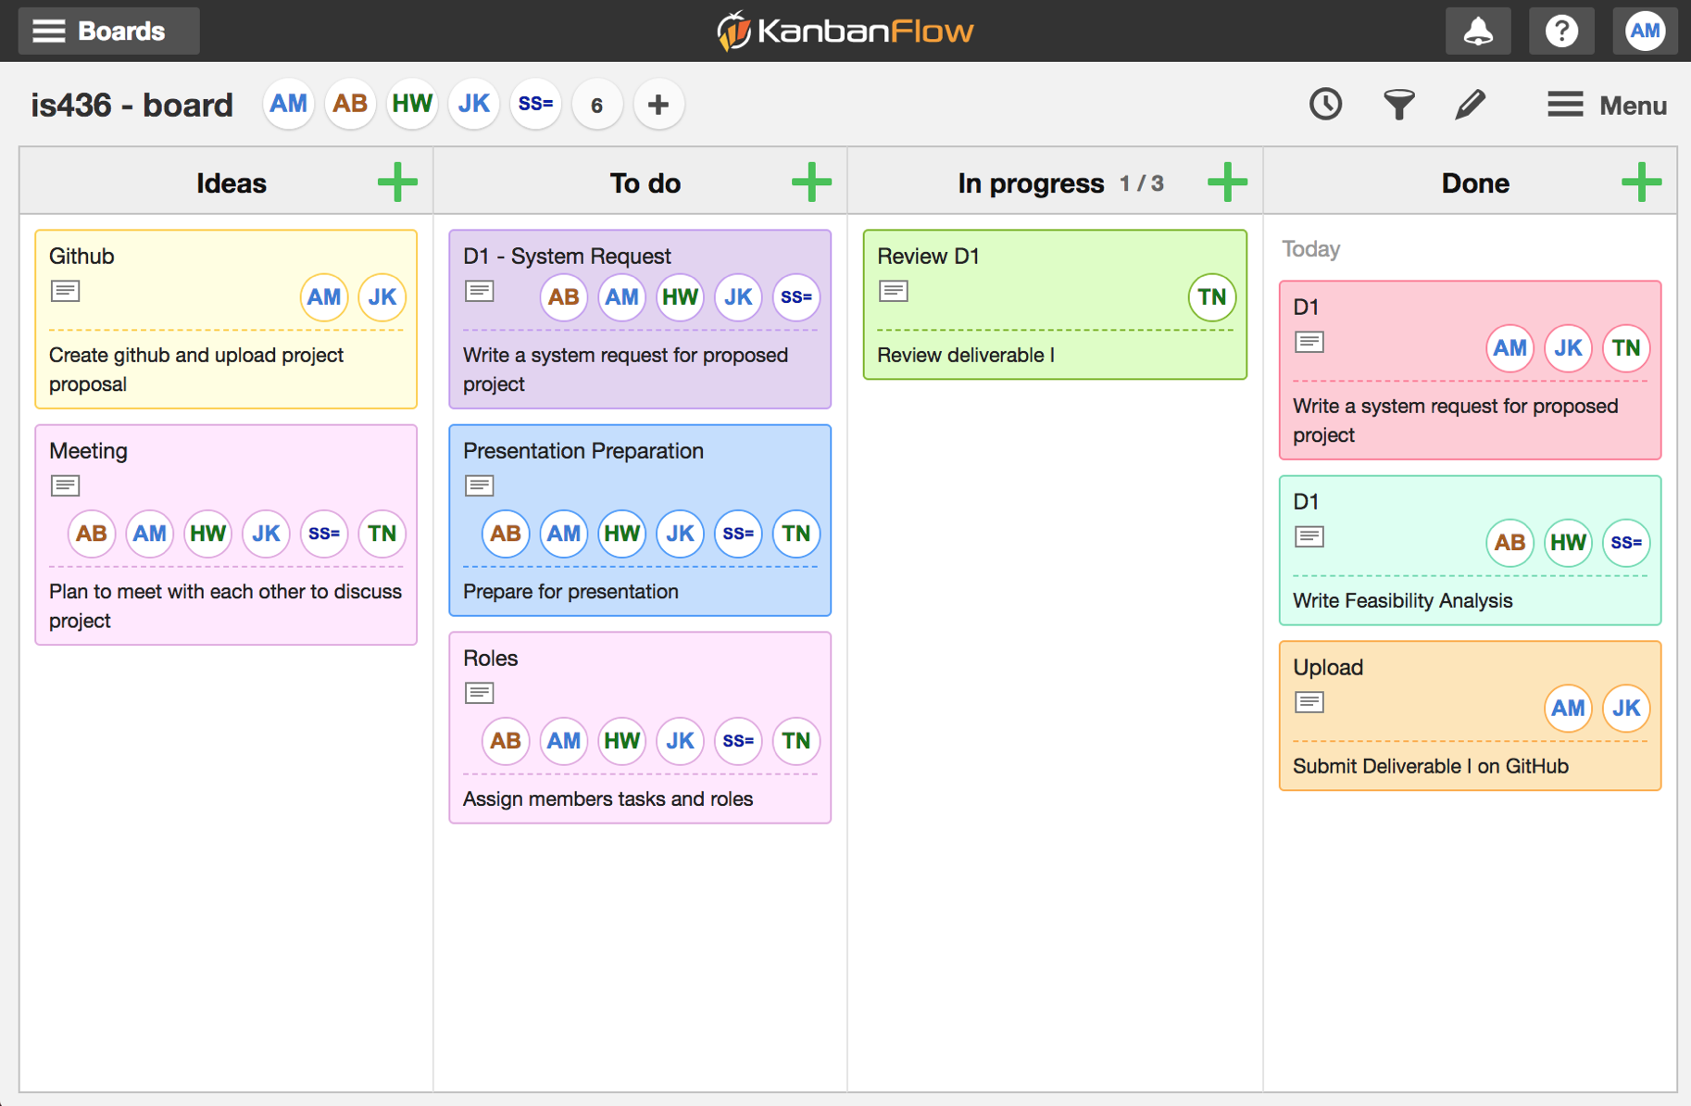

Slide 7
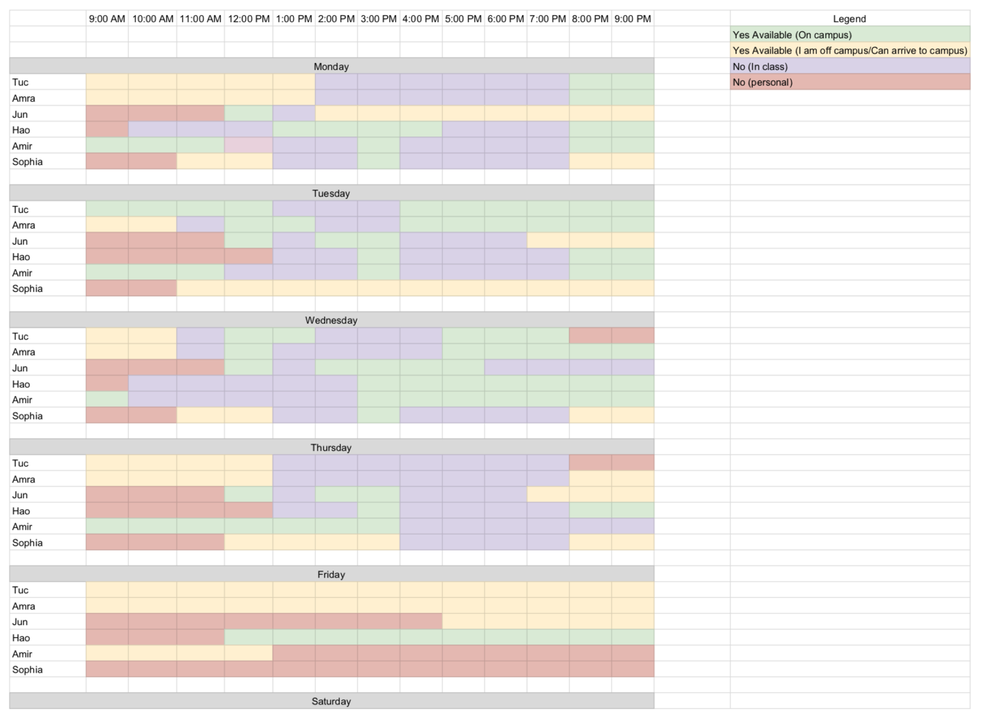

Slide 8
Questions?

